Slide 1
Bubble sort

Slide 2
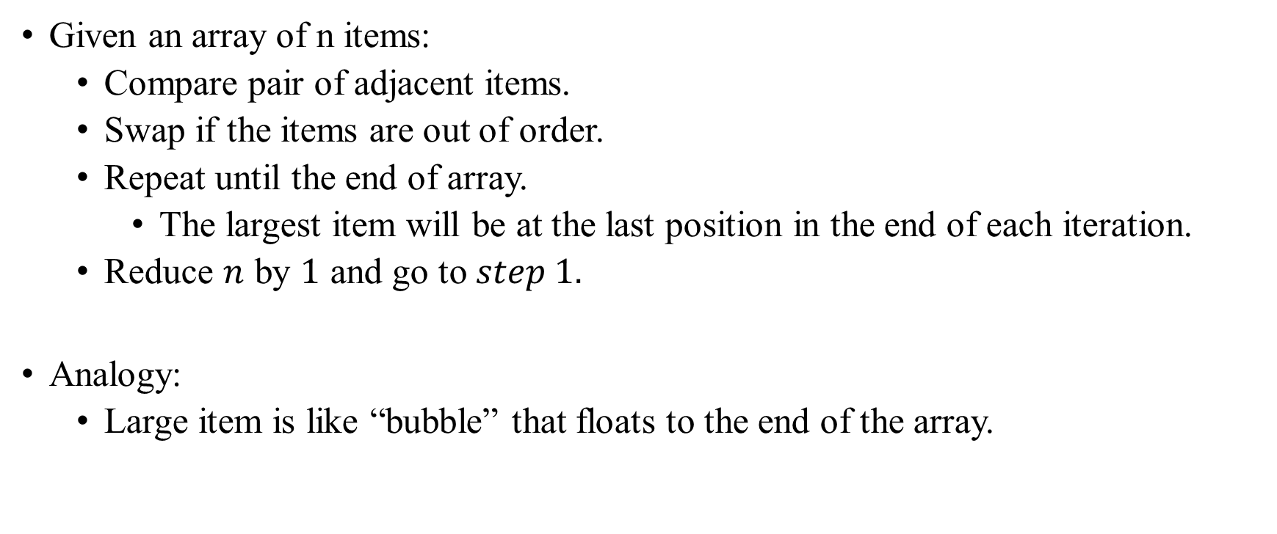
Bubble Sort Idea

Slide 3
Bubble Sort Example
29 | 10 | 14 | 37 | 13

Slide 4
Bubble Sort Example
29 | 10 | 14 | 37 | 13
Comparing 29 and 10, and swapping them

Slide 5
Bubble Sort Example
10 | 29 | 14 | 37 | 13
Comparing 29 and 10, and swapping them

Slide 6
Bubble Sort Example
10 | 29 | 14 | 37 | 13
Comparing 29 and 14, and swapping them

Slide 7
Bubble Sort Example
10 | 14 | 29 | 37 | 13
Comparing 29 and 14, and swapping them

Slide 8
Bubble Sort Example
10 | 14 | 29 | 37 | 13
Comparing 29 and 37, and do nothing

Slide 9
Bubble Sort Example
10 | 14 | 29 | 37 | 13
Comparing 37 and 13, and swapping them

Slide 10
Bubble Sort Example
10 | 14 | 29 | 13 | 37
Comparing 37 and 13, and swapping them

Slide 11
Bubble Sort Example
10 | 14 | 29 | 13 | 37
Largest element now in the end, performing again

Slide 12
Bubble Sort Example
10 | 14 | 29 | 13 | 37
Comparing 10 and 14, and do nothing

Slide 13
Bubble Sort Example
10 | 14 | 29 | 13 | 37
Comparing 14 and 29, and do nothing

Slide 14
Bubble Sort Example
10 | 14 | 29 | 13 | 37
Comparing 29 and 13, and swapping them

Slide 15
Bubble Sort Example
10 | 14 | 13 | 29 | 37
Comparing 29 and 13, and swapping them

Slide 16
Bubble Sort Example
10 | 14 | 13 | 29 | 37

Slide 17
Bubble Sort Example
10 | 14 | 13 | 29 | 37
Comparing 10 and 14, and do nothing

Slide 18
Bubble Sort Example
10 | 14 | 13 | 29 | 37
Comparing 14 and 13, and swapping them

Slide 19
Bubble Sort Example
10 | 13 | 14 | 29 | 37
Comparing 14 and 13, and swapping them

Slide 20
Bubble Sort Example
10 | 13 | 14 | 29 | 37

Slide 21
Bubble Sort Example
10 | 13 | 14 | 29 | 37
Comparing 10 and 13, and do nothing

Slide 22
Bubble Sort Example
10 | 13 | 14 | 29 | 37
Comparing 10 and 13, and do nothing

Slide 23
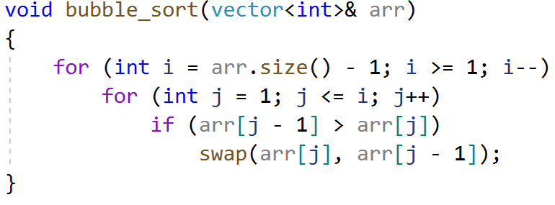
Bubble Sort Implementation

Slide 24
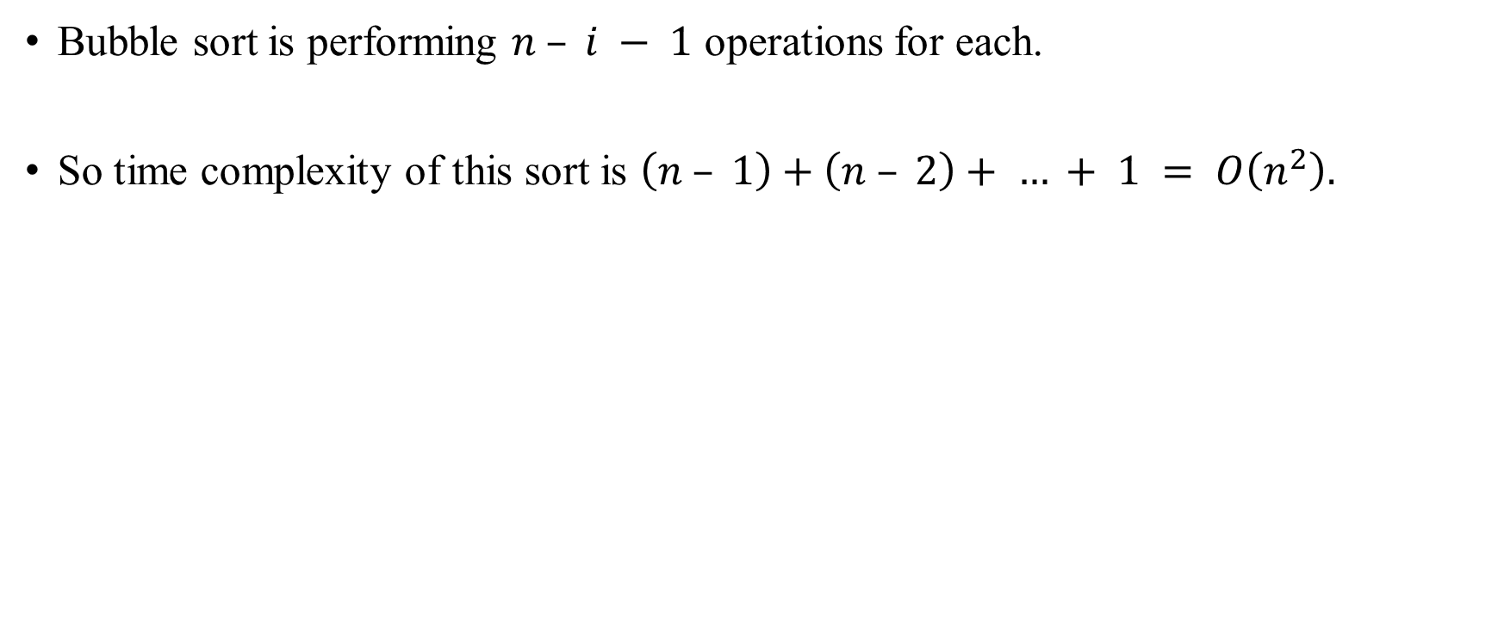
Bubble Sort Analysis

Slide 25
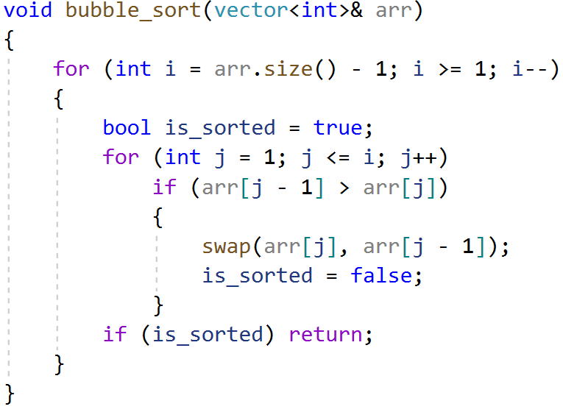
Bubble Sort Optimization
If we go through the inner loop with no swapping, then the array is already sorted and we can stop early.

Slide 26
Bubble Sort Optimization
Worst-case:
Input is in descending order.
Running time remains the same: O(n²).
Best-case:
Input is already in ascending order.
The algorithm returns after a single outer iteration.
Running time: O(n).

